Slide 1

THE ATLAS GAME

Slide 2


The player gets one chance to give a country before the computer goes
This is a country only ATLAS
No inappropriate input(United states of America cant be given as America)
Normal ATLAS rules apply.
to stop playing say "I want to stop playing"

Slide 3

OUR OBJECTIVE
OUR OBJECTIVE IS TO HELP CHILDREN PLAY THE GAMES WHICH THEY USED TO PLAY BUT NOW UNABLE TO PLAY DUE TO COVID
IN FACT THIS APP HELPS CHILDREN TO LEARN ABOUT NEW COUNTRIES WITH HAVING FUN
IN FUTURE I WOULD LIKE IT TO MAKE IT MULTIPLAYER

Slide 4
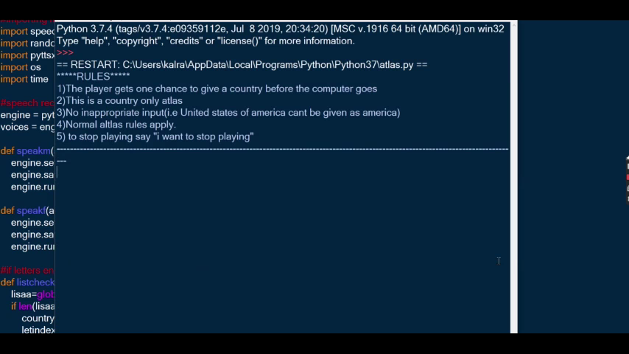
DEMO OF OUR PROJECT
Press spacebar

Slide 5

OUR APPLICATIONS TRYS TO UNDERSTAND YOU AND PLAY THE GAME AT IT’S BEST

Slide 6


